Slide 1
Windows Forms and Basic Controls
Programming – Introduction to C#
Last modified 12/12/16 by Alex Mackay

Slide 2
Contents
Windows Forms Overview
Creating a New Windows Form
Event Driven Programming
Creating Event Handlers in Windows Forms
Windows Forms Controls
User Input
Dialog Boxes

Slide 3
Windows Forms Overview
Develop smart clients
Easy to deploy and update, work connected or disconnected from internet
Access local resources in a more secure manner
Form: visual surface to display information to the user
Control: a discrete UI element displaying data or accepting input
Added to forms
Respond to user actions
Notes:
With Windows Forms you develop smart clients.
Smart clients are graphically rich applications that are easy to deploy and update, can work when they are connected to or disconnected from the Internet, and can access resources on the local computer in a more secure manner than traditional Windows-based applications.
In Windows Forms, a form is a visual surface on which you display information to the user. You ordinarily build Windows Forms applications by adding controls to forms and developing responses to user actions, such as mouse clicks or key presses.
A control is a discrete user interface (UI) element that displays data or accepts data input.
When a user does something to your form or one of its controls, the action generates an event. Your application reacts to these events by using code, and processes the events when they occur.

Slide 4
Windows Forms Overview
Windows Forms contains a variety of controls:
Text boxes, buttons, drop-down boxes, radio buttons, Web pages, and more
Rich UI controls
ToolStrip and MenuStrip
Supports creating custom controls
VS includes a drag-and-drop
Notes:
Windows Forms contains a variety of controls that you can add to forms: controls that display text boxes, buttons, drop-down boxes, radio buttons, and even Web pages.
Windows Forms has rich UI controls that emulate features in high-end applications like Microsoft Office. When you use the ToolStrip and MenuStrip control, you can create toolbars and menus that contain text and images, display submenus, and host other controls such as text boxes and combo boxes.
If an existing control does not meet your needs, Windows Forms also supports creating your own custom controls using the UserControl class.
With the Visual Studio drag-and-drop Windows Forms Designer, you can easily create Windows Forms applications.
Just select the controls with your cursor and add them where you want on the form.
The designer provides tools such as gridlines and snap lines to take the hassle out of aligning controls.
You can also create advanced form layouts using the FlowLayoutPanel, TableLayoutPanel and SplitContainer controls.

Slide 5
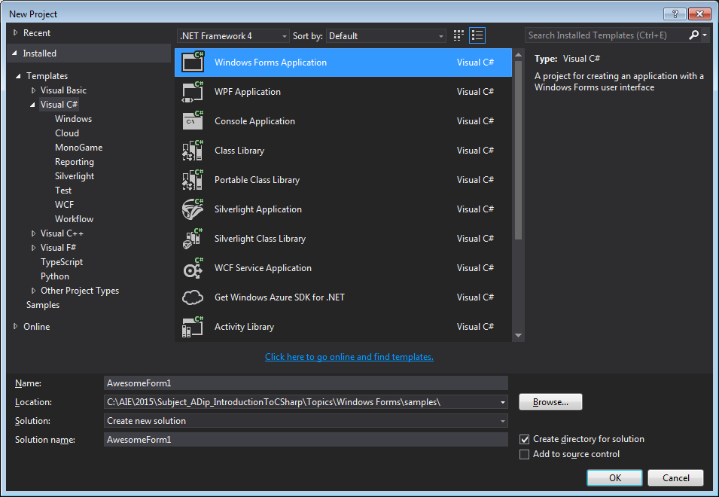
Creating a New Form
Notes:
Complete code in samples/AwesomeForm1
Start Visual Studio
From the list of Visual C# applications, select Windows Form Application
Enter an awesome name for your project

Slide 6
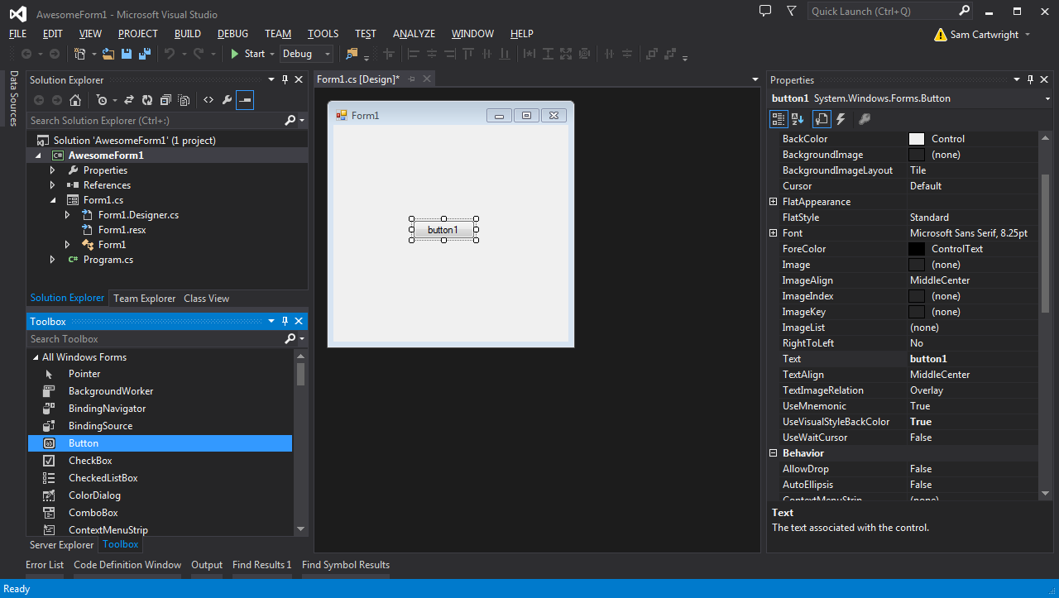
Creating a New Form
Notes:
If the Toolbox isn’t already displayed, select it from the View menu.
Drag and drop a button onto the form.
Open the Properties view to view or modify the properties of the button (like its name or display text).

Slide 7
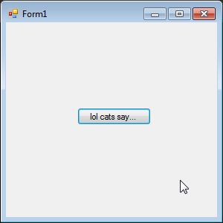
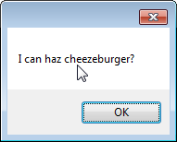
Creating a New Form
private void button1_Click(object sender, EventArgs e)
{
MessageBox.Show("I can haz cheezeburger?");
}
Notes:
Set some properties for your button (changing the Text property is a good place to start)
Double-click on the button and some event handling code will be created for you.
We’ll go over how to add other events later.
The code to handle the Click event is created. Add some code to display a simple message box.

Slide 8
Event Driven Programming
Traditional – the program itself fully dictates what code is executed and when
C# incorporates an event-driven programming model
Execute code in response to an event
No pre-determined order of events
Many events occur in conjunction with other events
Notes:
Traditional programming languages (often referred to as procedural languages) are where the program itself fully dictates what code is executed and when
C# incorporates an event-driven programming model
Event-driven programs aren’t bound by the constraints of procedural programs
Instead of the top-down approach of procedural languages, event driven programs have logical sections of code placed within events
Event-driven applications execute code in response to an event. Each form and control exposes a predefined set of events that you can program against. If one of these events occurs and there is code in the associated event handler, that code is invoked.
The types of events raised by an object vary, but many types are common to most controls. For example, most objects will handle a Click event. If a user clicks a form, code in the form's Click event handler is executed.
There is no predetermined order in which events occur, and often the user has complete control over what code is executed in an even-driven program
Many events occur in conjunction with other events. For example, in the course of the DoubleClick event occurring, the MouseDown, MouseUp, and Click events occur.

Slide 9
Creating Event Handlers in Windows Forms
Event Handler: function determining what actions are performed when an event occurs
For example, a button click
Events can be assigned to multiple handlers
The methods that handle particular events can be changed dynamically
Use the Forms Designer to create event handlers
Notes:
An event handler is a procedure in your code that determines what actions are performed when an event occurs, such as when the user clicks a button or a message queue receives a message.
When an event is raised, the event handler or handlers that receive the event are executed.
Events can be assigned to multiple handlers, and the methods that handle particular events can be changed dynamically.
You can also use the Windows Forms Designer to create event handlers.

Slide 10
Creating Event Handlers in Windows Forms
private void button1_Click(object sender, EventArgs e)
{
MessageBox.Show("I can haz cheezeburger?");
}
Event handlers provide 2 parameters
sender: reference to the object that raised the event
e: an object specific to the event being handled
Obtain information such as location of mouse (mouse events) or data transferred (drag-and-drop events)
Notes:
An event handler is a method that is bound to an event.
When the event is raised, the code within the event handler is executed.
Each event handler provides two parameters that allow you to handle the event properly.
The example in this slide shows an event handler for a Button control's Click event.
The first parameter, sender, provides a reference to the object that raised the event.
The second parameter, e, in the example above, passes an object specific to the event that is being handled.
By referencing the object's properties (and, sometimes, its methods), you can obtain information such as the location of the mouse for mouse events or data being transferred in drag-and-drop events.
Typically each event produces an event handler with a different event-object type for the second parameter.
Some event handlers, such as those for the MouseDown and MouseUp events, have the same object type for their second parameter. For these types of events, you can use the same event handler to handle both events.

Slide 11
Windows Forms (Basic) Controls
Button: Presents a standard button that the user can click to perform actions
CheckBox: Indicates whether a condition is on or off
ColorDialog: Select a colour from a palette in a pre-configured dialog box
ComboBox: Displays data in a drop-down combo box
DateTimePicker: Select from a list of dates or times
FileDialog: Functionality for file dialog boxes
Label: Displays text that cannot be edited by the user

Slide 12
Windows Forms (Basic) Controls
ListView: Displays a list of items with icons, in the manner of Windows Explorer
PictureBox: Displays graphics in BMP, GIF, JPEG, metafile, or icon format
ProgressBar: Graphically indicates progress of an action
RichTextBox: Enter, display, and manipulate text with formatting
ToolBar: Displays menus and bitmapped buttons that activate commands
WebBrowser: Hosts Web pages and provides Web browsing capabilities
https://msdn.microsoft.com/en-us/library/3xdhey7w(v=vs.110).aspx

Slide 13
User Input
Sent to applications as Windows messages
Processed by a series of overridable methods
These methods raise events to be handled by the Windows Form Application
You can query the event to get information about the mouse/keyboard input
Notes:
Windows Forms includes a user input model based on events that are raised while processing related Windows messages.
In Windows Forms, user input is sent to applications in the form of Windows messages.
A series of overridable methods process these messages at the application, form, and control level.
When these methods receive mouse and keyboard messages, they raise events that can be handled to get information about the mouse or keyboard input.
In many cases, Windows Forms applications will be able to process all user input simply by handling these events. In other cases, an application may need to override one of the methods that process messages in order to intercept a particular message before it is received by the application, form, or control.
[This is saying that most of the time messages from the system are automatically sent to the form and you can just override an event handler to process an event. But there may be times when you need to override the message methods so that you can intercept a specific message, and then process that message (before it is received by the app/form/control) ]

Slide 14
Keyboard and Mouse Events
All form controls inherit a set of events for mouse/keyboard input
For example, KeyPress event to determine the character code of a key pressed, or
MouseClick event to determine the location of a mouse click
Notes:
All Windows Forms controls inherit a set of events related to mouse and keyboard input.
For example, a control can handle the KeyPress event to determine the character code of a key that was pressed, or a control can handle the MouseClick event to determine the location of a mouse click.

Slide 15
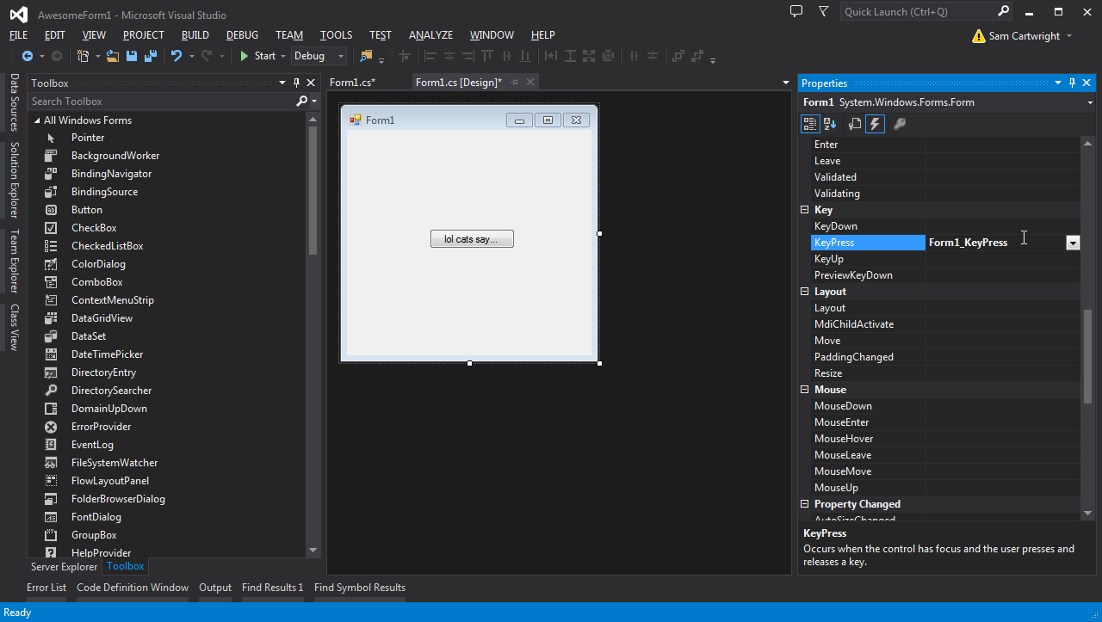
KeyPress Event
Notes:
Windows Forms provides the ability to handle keyboard messages at the form level, before the messages reach a control.
In the Properties window, select the lightening bolt to show all the events for the form.
Double-click the KeyPress event to add that event.

Slide 16
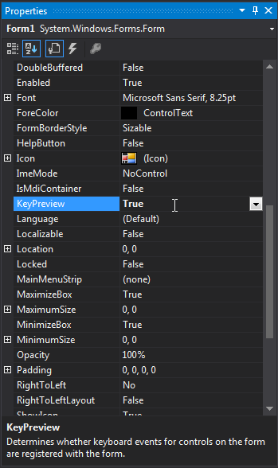
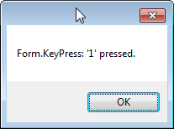
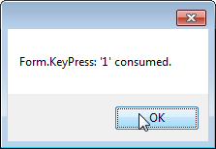
KeyPress Event
// Detect all numeric characters at the form level and consume 1,
// 4, and 7. Note that Form.KeyPreview must be set to true for this
// event handler to be called.
private void Form1_KeyPress(object sender, KeyPressEventArgs e)
{
if (e.KeyChar >= 48 && e.KeyChar <= 57)
{
MessageBox.Show("Form.KeyPress: '" +
e.KeyChar.ToString() + "' pressed.");
switch (e.KeyChar)
{
case (char)49:
case (char)52:
case (char)55:
MessageBox.Show("Form.KeyPress: '" +
e.KeyChar.ToString() + "' consumed.");
e.Handled = true;
break;
}
}
}
Notes:
Set the KeyPreview property of the form to true so that keyboard messages are received by the form before they reach any controls on the form.
The code on this slide will handle the event and consume the 1, 4, and 7 keys. All other key press events are not handled and so will remain in the message queue to potentially be consumed by other controls.

Slide 17
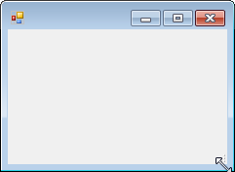
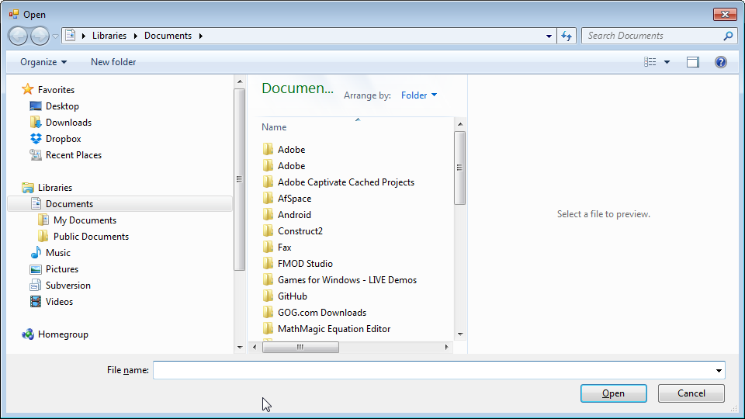
Dialog Boxes
private void button2_Click(object sender, EventArgs e)
{
Form dlg1 = new Form();
dlg1.ShowDialog();
}
private void button2_Click(object sender, EventArgs e)
{
OpenFileDialog dlg1 = new OpenFileDialog();
dlg1.ShowDialog();
}
Notes:
These code segments show how to create dialog boxes in code.
In the first one we are creating a blank form, and showing this form as a dialog box. You could change Form to be any form class in your application (so what would happen if you changed this to Form1?)
In the second segment we are opening a new OpenFileDialog.
There are pre-made dialog classes for most common tasks.

Slide 18
Summary
Windows Forms contains a variety of rich UI controls
Easily drag-and-drop using the Forms Designer
Set properties to change the appearance of controls
Add event handlers to respond to user input
Create custom dialogs or use existing ones

Slide 19
Further Reading
Microsoft, Windows Forms, MSDN
https://msdn.microsoft.com/en-us/library/dd30h2yb(v=vs.110).aspx

